Slide 1
Tech Devision

Slide 2
Branch
Branch ada 3 (development, staging, production)
Web
Development : https://dev-app-santrihub.netlify.app/
Staging : https://staging-app-santrihub.netlify.app/
Production : https://app-santrihub.vercel.app/
Database
Development :
Staging :
Production :

Slide 3
Improvement Web
Penyesuaian menu di navbar (dikurangi biar user dengan email Panjang bs ke cover dan tidak merusak tampilan menu)

Slide 4
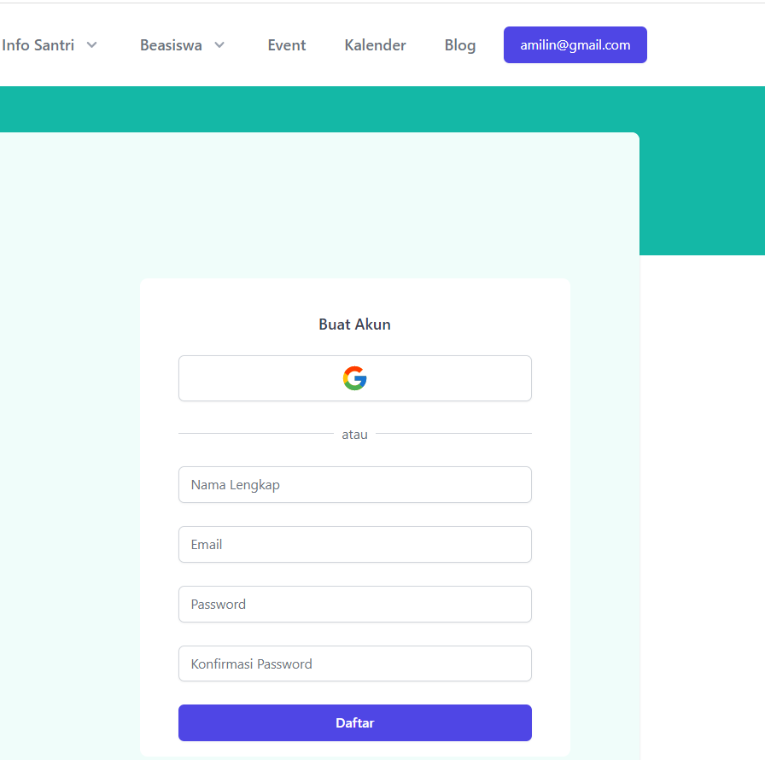
Improvement Web
Ketika user sudah login, apakah form register masih muncul ?

Slide 5
Improvement Web
Remix Js → Next Js
Refactor code frontend

Slide 6
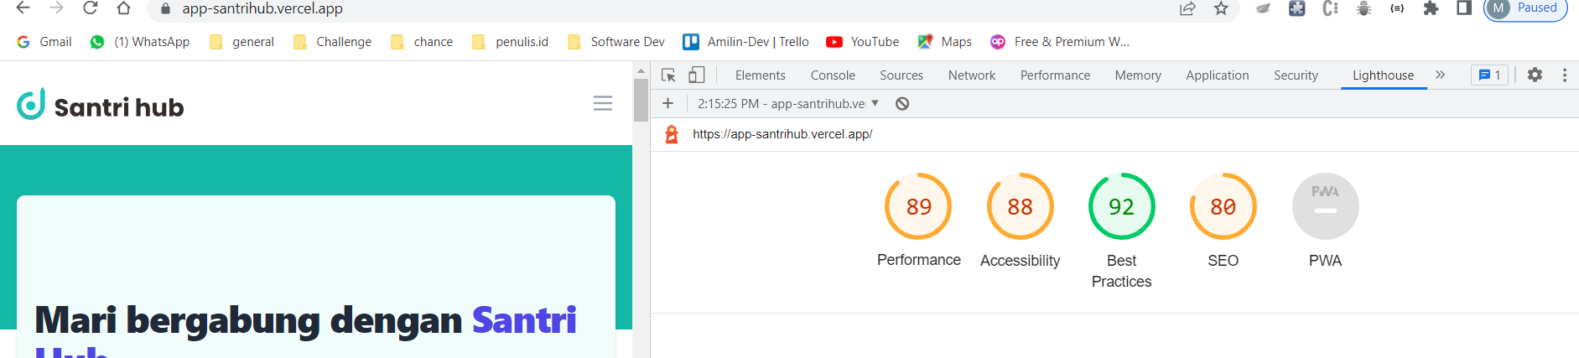
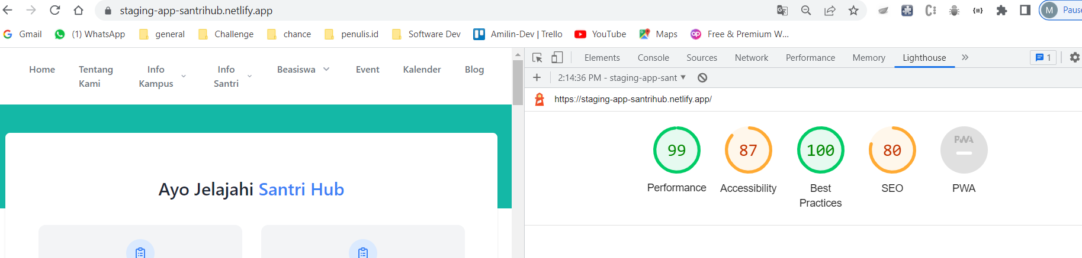

Slide 7
Fitur Tambahan
Authentication via google

Slide 8
Branching
Hari 1
git clone -b development https://github.com/santrihub-id/app
git checkout -b nama_branch
git pull origin development
Hari 2 (masih di branch yang sama)
git pull origin development
git push origin nama_branch
** meminimalisir conflict sebelum push, lakukan git pull origin development

